Slide 1
GRAPHICAL SECRET KEY VERIFICATION SYSTEM
GUIDE MEMBERS
A.KANCHANA DHARSHINI.S – 2018PECCS125
JOSEPHINE BENITA.T – 2018PECCS145
KAMALI.B - 2018PECCS146

Slide 2
ABSTRACT
Computer security depends largely on passwords to authenticate human users from attackers.
The most common computer authentication method is to use alphanumerical usernames and password.
Users tend to pick password that can be easily guessed.
So,here we are using three step authentication system ,in order to keep our information highly secure.
The three step verification systems are as follows:
Alpha numerical user name and password.
Picking the colours in the correct sequence.
Drag and drop the image in grid(pattern).

Slide 3
OBJECTIVES 1
Textual passwords are the most often used authentication method for all websites and services.
Textual passwords are made up of a series of letters and numbers that may or may not include special characters or numbers.
In most circumstances, users can log into several accounts with just one username and password. However, they are not completely secure.
Users may have difficulty remembering a password that is long and random appearing. Instead, they create short, simple, and insecure passwords.

Slide 4
OBJECTIVES 2
Graphical passwords have been designed to try to make passwords more memorable and easier for people to use and, therefore, more secure.
Using a graphical password, users click on images and colours rather than typing alphanumeric characters.
This graphical password authentication system can be applied to any sector.

Slide 5
OVERVIEW 1
Graphical password authentication system can be applied to any sector.
Initially , We have the option to register. We will first click on the register button after that we have to enter our details .
Alpha numerical user name and password.
The first level of authentication will be a normal authentication
After entering our details, click on the next button.

Slide 6
OVERVIEW 2
Picking the colours in the correct sequence.
Next the level two of authentication will be to create a pattern of colours by selecting it so quickly.
If we want to select green ,red,blue then my colour pattern will be green, red, blue for authentication .
Drag and drop the image in grid(pattern).
Next the level three of authentication is,where we have to drag and drop the images to create a pattern of colours.

Slide 7
List of modules 1
Module for the General Public
It is the end of a website's complete browsing experience.This module can be accessed by anybody who has the URL.
Although it is open to the public, they are unable to edit or amend the information.
Module for Users
The user module contains the registered users. Registration and Login are the two functions of the user module.

Slide 8
List of modules 2
During registration, the system captures the user's basic information such as name, phone number, and email address, as well as a textual and graphical password. All of this is encrypted and saved in the database.
The user will provide the username, textual password, and image password for accessing the resource during the login step. It compares the given values to the information provided by the user during the registration process. He/she will be logged into the page if it matches.

Slide 9
List of modules 3
Account and Preferences
This is the third module, which houses the client's information as well as the computerised web stage's many settings. The user module and the account module are linked; once the user completes the registration process, the account will be established in the database. Additionally, individuals have the ability to change their passwords at any moment. Its advantages include sign-in data, privacy and security options, and so on. Clients can also receive warnings and request assistance from this section.

Slide 10
Technology
Node.js
CSS
Webpack

Slide 11
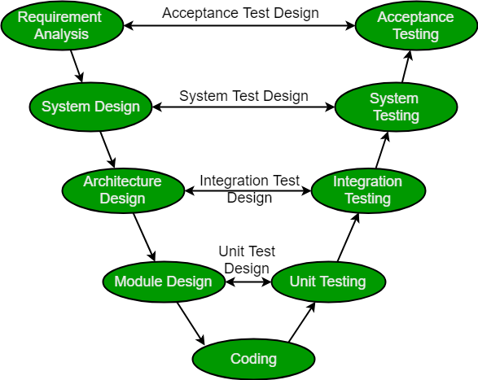
SDLC

Slide 12
TIMELINE CHART
s.no | Description
1 | Requirements analysis | 5days
2 | Existing system Study & literature | 2 days
3 | Modular specifications | 2 week
4 | Design &modelling | 2 week
5 | Coding & implementation | 3 to 4 week
6 | Testing | 1 week
7 | Performance evaluation | 3 days

Slide 13
Reference
[1] Abhijith S, Sreelekshmi K,’ Web based Graphical Password Authentication System ‘,2021 International Journal of Engineering Research & Technology (IJERT)
[2] Salisu Ibrahim Yusuf, Moussa Mahamat Boukar, ‘User Define Time Based Change Pattern Dynamic Password AuthenticationScheme’,2018 InternationalConference on Electronics Computer
[3] Yang Jingbo, Shen Pingping,’ A secure strong password authentication protocol”, 2010 International Conference on Software Technology and Engineering
[4] Hua Wang, Yao Guo, Xiangqun Chen,’ DPAC: A Reuse-Oriented Password Authentication Framework for Improving Password Security’’, 2008 IEEE High Assurance Systems Engineering Symposium
[5] Salah Refish, ‘PAC-RMPN: Password Authentication Code Based RMPN’, 2018 International Conference on AdvancedScience and Engineering (ICOASE)

